Slide 1


C++ std::generator
Coroutine
A Comprehensive Guide to C++23's First Concrete Coroutine Type
C++23
|
Coroutines
|
Ranges

Slide 2
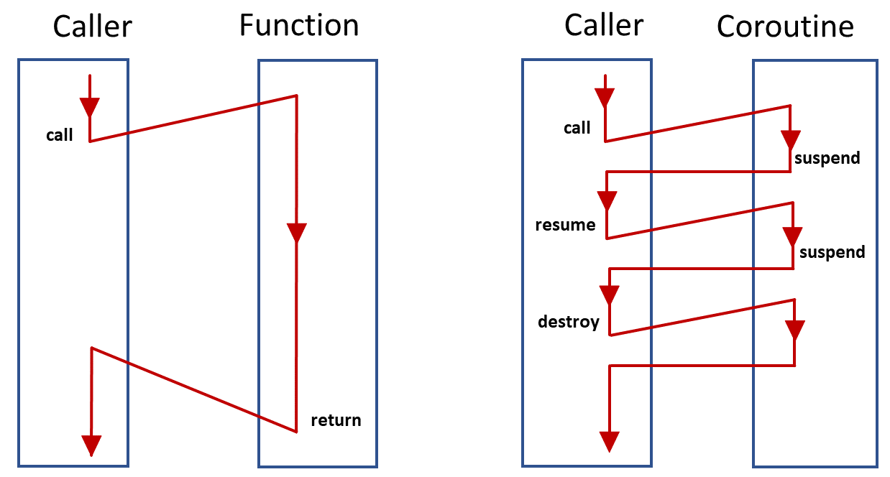




Introduction to std::generator
What is it?
A view of elements yielded by a coroutine
23
C++23 Standard
First concrete coroutine type
Builds on C++20
Uses coroutine framework
Range Compatible
Models view & input_range
Lazy Evaluation
Generates sequences on-demand
Coroutine execution flow vs. Function calls

Slide 3

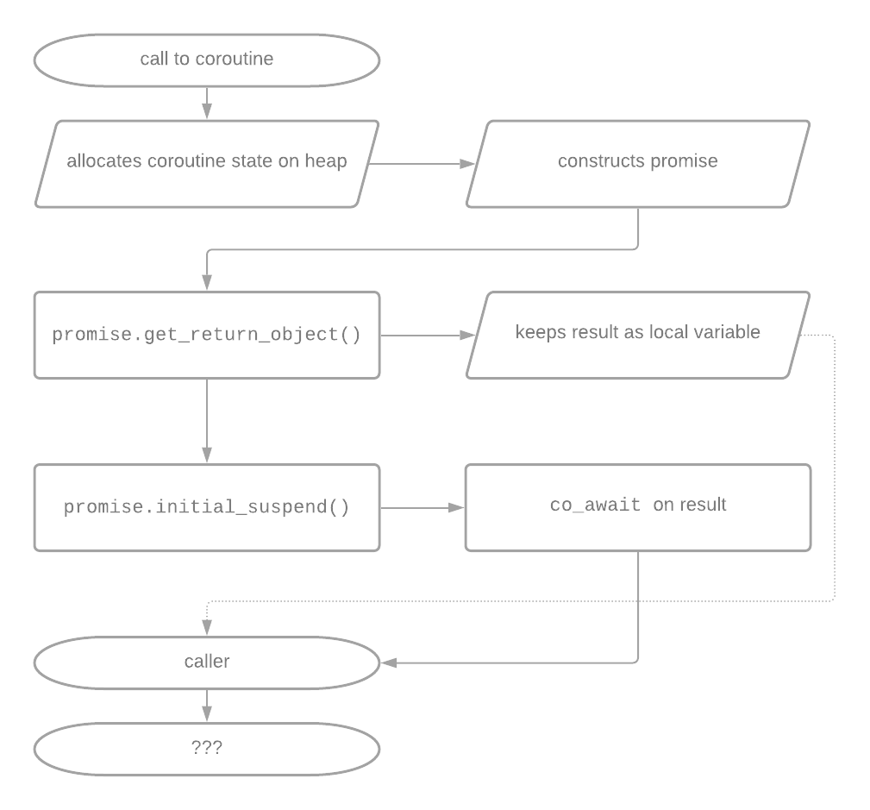




Basic Syntax and Concepts
The co_yield Keyword
Yields both control flow and value back to caller
How Coroutines Work
1
Generalized subroutines that can suspend and resume
2
State maintained between suspensions
3
Determined by coroutine's return type
Suspend
Resume
Pause execution
Continue execution
Coroutine internal mechanism & state management

Slide 4






Basic Example - Fibonacci Sequence
Infinite Generator
Generator Function
Produces endless sequence of Fibonacci numbers
Value Update
Uses std::exchange to efficiently update sequence values
Lazy Evaluation
Usage Example
Only generates values when requested
Range Adaptors
Works seamlessly with ranges library views

Slide 5
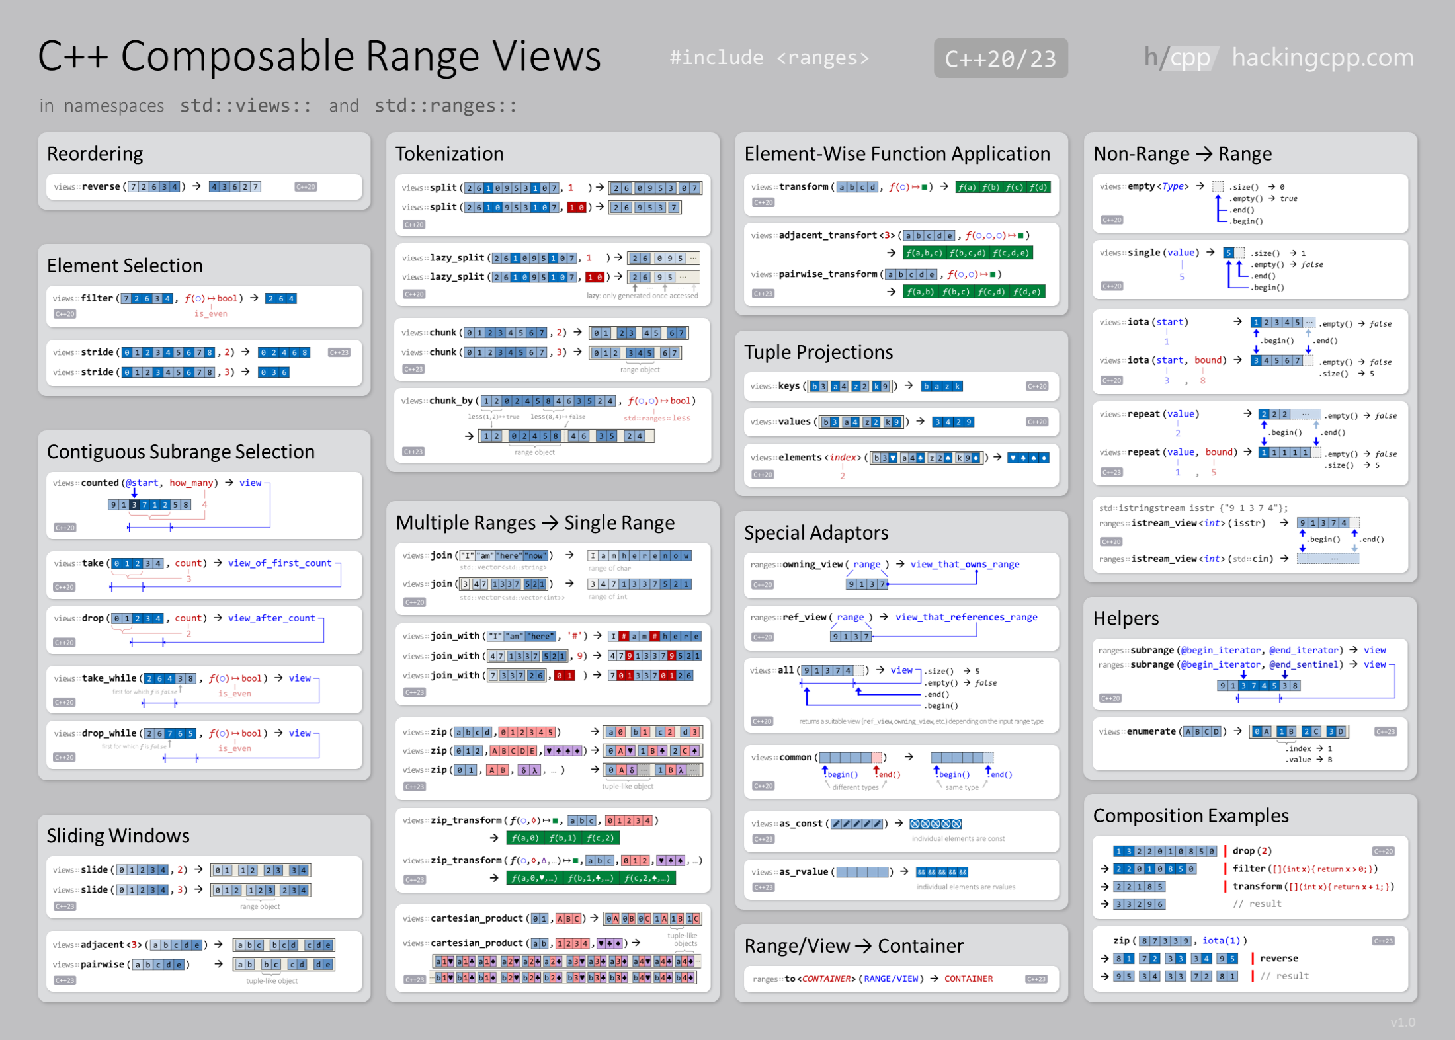







Integration with Ranges Library
Using fold_left
Pipe Operator
Chain operations using | for readability
Common Range Adaptors
Lazy Execution
drop(n)
take(n)
Values only generated when requested
filter(pred)
transform(fn)
Composable Views
Combine multiple range adaptors seamlessly

Slide 6

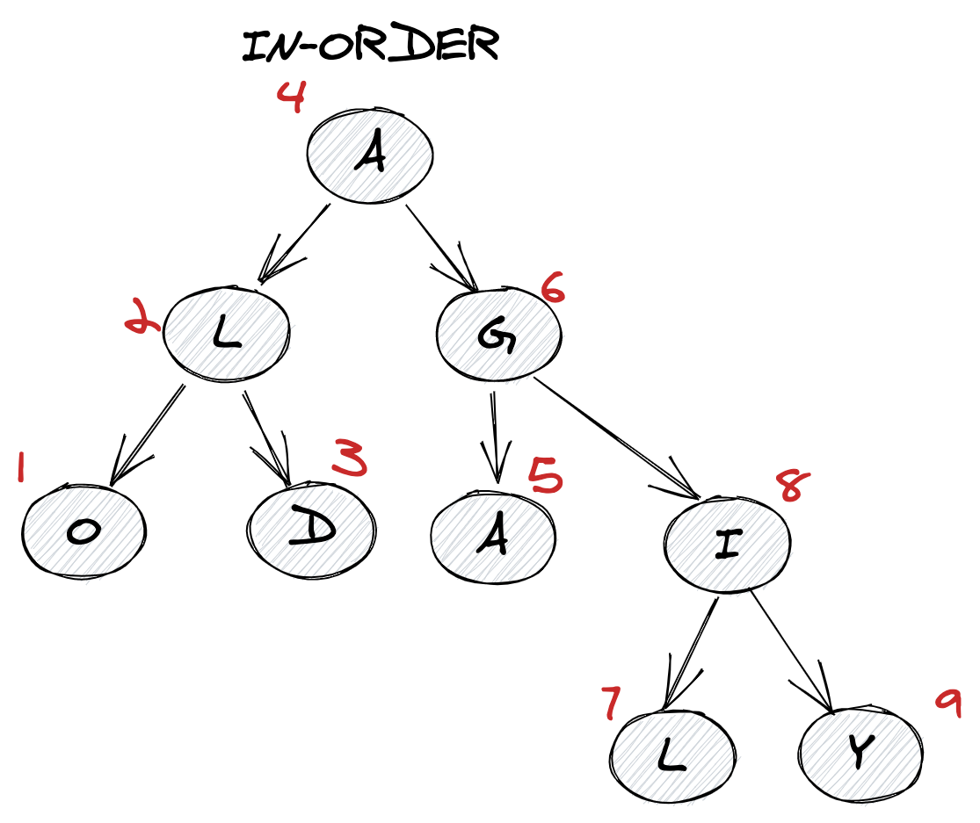


Tree Traversal - Recursive Generators
In-Order Traversal
In-Order: Left → Root → Right
Recursive Yielding
Usage
std::ranges::elements_of flattens nested generators
Elegant Recursion
Complex algorithms made simple with coroutines

Slide 7






Comparison with Custom Ranges
std::generator
Custom Range
Simple & Concise
Complex & Verbose
Iterator class with member types
Multiple constructors
Operator overloads
enable_borrowed_range
~50+ lines of code
Trade-offs
Capabilities
Input Range (single-pass)
Forward Range
Move-only
Copyable
Not Borrowed Range
Borrowed Range
Clear Winner
Simplicity & maintainability for most use cases

Slide 8





Design Decisions and Trade-offs
Move-only
Input_range
Not copyable
Single-pass, not forward_range
Coroutine state is a unique resource — cannot deep copy, all handles see same state
Limits some algorithms — cannot use with max_element or other multi-pass operations
Synchronous
Recursive
No co_await support
Can yield generators directly
Cannot co_await async operations inside generator body — purely synchronous
Enables recursive algorithms — use std::ranges::elements_of to flatten nested generators
Design choices prioritize simplicity and performance for common use cases

Slide 9







Advanced Use Cases
Lazy Evaluation
Infinite Sequences
Type-Erasure
Generate values on-demand
Use generators without templates
Generate unbounded data streams
Defer computation until needed
Enables modular library design
Fibonacci, prime numbers
Conserve memory usage
Random number streams
Hide implementation details
Handle infinite sequences naturally
Process with views::take
Useful for library APIs
Choose generators for lazy computation, unbounded streams, or modular APIs

Slide 10







Performance Considerations
Memory Allocation
Stack Management
Coroutine state on heap (unique_ptr)
Stack grows as generators are yielded
Each generator owns its own stack
Shrinks when generators complete
Nested generators maintain separate stacks
Efficient for deep recursion
Performance Tips
Prefer value types over reference types
Use std::pmr::generator for custom allocators
Avoid excessive nesting in hot paths
Leverage move semantics for generators
Benchmarking Results
Performance comparable to iterator-based ranges for most use cases. Overhead is minimal for typical scenarios and often offset by code simplicity and maintainability benefits.

Slide 11





Practical Examples
Random Numbers
File Parsing
Data Pipeline
Complex transformations made readable
Generators transform complex data processing into readable, efficient code

Slide 12







Conclusion and Best Practices
When to Use
Pitfalls to Avoid
Future in C++
Generating sequences on-demand
Not for forward_range algorithms
More concrete types coming
Improved performance
Lazy evaluation scenarios
Avoid excessive nesting
Better memory management
Infinite data streams
Remember: move-only type
Enhanced stdlib integration
Recursive algorithms
No co_await inside
Wider compiler support
Simplicity over max performance
Single-pass iteration only
std::generator makes coroutines accessible and practical for everyday C++ development

